Slide 1
SOFTWARE DESIGN
Spring 2011
Computer Science Department, TUC-N
Advanced Modeling with UML

Slide 2
OVERVIEW
Spring 2011
Introduction
Advanced Modeling
  Part 1: Extension Mechanisms
    Bran Selic, Rational Software
    Nathan Dykman, Hewlett Packard
  Part 2: Object Constraint Language (OCL)
    Jos Warmer, Klasse Objecten
    Bran Selic, Rational Software
Computer Science Department, TUC-N

Slide 3
FOCUS: THE LANGUAGE
Spring 2011
language = syntax + semantics
  syntax = language elements (e.g. words) are assembled into expressions (e.g. phrases, clauses)
  semantics = the meanings of the syntactic expressions
UML Notation Guide – defines UML’s graphic syntax
UML Semantics – defines UML’s semantics
Computer Science Department, TUC-N

Slide 4
UML OVERVIEW
Spring 2011
«metamodel»
UML
Behavioral
Elements
Model
Management
Computer Science Department, TUC-N
dependency
package
Foundation

Slide 5
UML OVERVIEW
Spring 2011
Behavioral
Elements
Model
Management
Foundation
Computer Science Department, TUC-N
Core
Extension
Mechanisms
Data Types

Slide 6
UML OVERVIEW
Spring 2011
Behavioral Elements
Use Cases
Collaborations
State Machines
Activity Graphs
Model
Management
Computer Science Department, TUC-N
Common Behavior
Foundation

Slide 7
SEMANTIC VARIATIONS IN UML
Spring 2011
UML contains semantic aspects that are:
  undefined, or
  ambiguous (multiple choices/interpretations)
Why is this the case?
  UML can’t address every domain perfectly
  Different domains require different specializations
But, if UML can be extended in arbitrary ways, what is the value of having a standard?
Computer Science Department, TUC-N

Slide 8
UML AS A “FAMILY OF LANGUAGES”
Spring 2011
The standard can be specialized for different domains
  in effect: refinements of the standard
UML 1.4 Standard
Using
extensibility
mechanisms
Computer Science Department, TUC-N
UML for Real Time
UML for CORBA
etc.

Slide 9
EXTENSION MECHANISMS
Spring 2011
Extension Mechanisms
  Allow Modelers to refine the semantics of UML for a specific domain
Extensions cannot violate the standard UML semantics
  Enforces a consistent core of concepts and semantics for every variation
  Prevents meta-model explosion (Using UML to model everything and anything)
Computer Science Department, TUC-N

Slide 10
HOW UML EXTENSION WORKS
Spring 2011
The standard UML semantics can be viewed as defining a space of possible interpretations
Standard UML semantics
refined semantics
(valid)
different semantics
(NOT valid)
Computer Science Department, TUC-N

Slide 11


MODELS
Spring 2011
A model is a description of something
  “a pattern for something to be made” (Merriam-Webster)
Computer Science Department, TUC-N
blueprint
(model)
building
building
model ≠ thing that is modeled
  The Map is Not The Territory

Slide 12
META-MODELS
Spring 2011
Are Simply Models of Models
<sawdust>
<2 tons>
<lard>
<5 tons>
Objects
(M0)
<Ben&Jerry’s>
Customer
CustomerOrder
Computer Science Department, TUC-N
Model
(M1)
id
item
quantity
Class
Association
Meta-Model
(M2)

Slide 13
THE UML META-MODEL
Spring 2011
Is a UML Model of UML
Meta-Class
GeneralizableElement
isRoot : Boolean
isLeaf : Boolean
isAbstract : Boolean
Feature
visibility : {public, private,
protected}
*
Computer Science Department, TUC-N
Classifier
Well-formedness constraint (OCL)
not self.isAbstract implies
self.allOperations->forAll(op |
self.allMethods->exists(m |
m.specification includes (op)))
Class
isActive : Boolean

Slide 14
THE UML META-MODEL
Spring 2011
Put another way, UML uses (a part of) itself as a Meta-language
  Other examples: Scheme, Lisp, Smalltalk
This small subset of UML is used to describe all of UML
  The subset contains classes, associations, operations, constraints, generalization, etc.
Computer Science Department, TUC-N

Slide 15
THE BASIC EXTENSIBILITY MECHANISMS
Spring 2011
Stereotypes
  used to refine meta-classes (or other stereotypes) by defining supplemental semantics
Constraints
  predicates (e.g., OCL expressions) that reduce semantic variation
  can be attached to any meta-class or stereotype
Tagged Values
  individual modifiers with user-defined semantics
  can be attached to any meta-class or stereotype
Computer Science Department, TUC-N

Slide 16
STEREOTYPES
Spring 2011
Used to define specialized model elements based on a core UML model element
Defined by:
  Base metaclasses (or stereotype)
    What element is specialized?
  Constraints:
    What is special about this stereotype?
  Required tags (0..*)
    What values does this stereotype need to know?
  Icon
    How should it appear in a model?
A model element can be stereotyped in multiple different ways
Computer Science Department, TUC-N

Slide 17
EXAMPLE
Spring 2011
Capsule: A special type of concurrent object used in modeling certain real-time systems
By definition, all classes of this type:
  are active (concurrent)
  have only features (attributes and operations) with protected visibility
  have a special “language” characteristic used for code generation purposes
In essence, a constrained form of the general UML Class concept
Computer Science Department, TUC-N

Slide 18
EXAMPLE: STEREOTYPE DEFINITION
Spring 2011
Using a tabular form:
Stereotype
Base Class
Tags
Constraints
«capsule»
Class
language
isActive = true;
self.feature->select(f |
f.oclIsKindOf(Operation))->
forAll(o |
o.elementOwnership.visibility
= #protected)
Computer Science Department, TUC-N
Tag
Stereotype
Type
Multiplicity
language
«capsule»
String
0..1

Slide 19
STEREOTYPE NOTATION
Spring 2011
Stereotype
icon
Several choices
«capsule»
aCapsuleClass
aCapsuleClass
Computer Science Department, TUC-N
(a) with guillemets
(b) with icon
(c) iconified form

Slide 20
EXTENSIBILITY METHOD
Refinements are specified at the Model (M1) level but apply to the Meta-Model level (M2)
  avoids need for “meta-modeling” CASE tools
  can be exchanged with models
Spring 2011
«capsule»
aCapsuleClass
Customer
CustomerOrder
«Capsule»
Computer Science Department, TUC-N
(M1)
id
item
quantity
Class
Association
(M2)

Slide 21
GRAPHICAL DEFINITION
Spring 2011
Alternative to the tabular form
  defined in a user (M1) model
«metaclass»
Class
«stereotype»
Computer Science Department, TUC-N
«stereotype»
capsule
Tags
language : String

Slide 22
HEURISTIC: COMBINING STEREOTYPES
Spring 2011
Through multiple inheritance:
«stereotype»
capsule
«metaclass»
Package
Tags
language : String
Computer Science Department, TUC-N
«stereotype»
«stereotype»
PackageCapsule

Slide 23
WHEN TO USE STEREOTYPES?
Spring 2011
Why not use normal subclassing instead?
Use stereotypes when:
  additional semantic constraints cannot be specified through standard M1-level modeling facilities
    e.g. “all features have protected visibility”
  the additional semantics have significance outside the scope of UML
    e.g. instructions to a code generator
    “debugOn = true”
Computer Science Department, TUC-N

Slide 24
TAGGED VALUES
Spring 2011
Consist of a tag and value pair
Typed with a standard data type or M1 class name
Typically used to model stereotype attributes
  Additional information that is useful/required to implement/use the model
May also be used independently of stereotypes
  e.g., project management data
  (“status = unit_tested”)
Computer Science Department, TUC-N
1.4

Slide 25
CONSTRAINTS
Spring 2011
Constraints
  formal or informal expressions
  must not contradict inherited base semantics
ATM_Withdrawal
Account
customer : id
amount : Money
{amount is multiple of $20}
customer : id
balance : Money
Computer Science Department, TUC-N
«constraint»
{ATM_Withdrawal.customer =
Account.customer}

Slide 26
UML PROFILES
Spring 2011
A package of related extensibility elements that capture domain-specific variations and usage patterns
  A domain-specific interpretation of UML
Profiles currently being defined by the OMG:
  EDOC
  Real-Time
  CORBA
  ...
Computer Science Department, TUC-N

Slide 27
ADVANCED MODELING WITH UML
Spring 2011
Part 1: Extension Mechanisms and Profiles
Part 2: Object Constraint Language (OCL)
Computer Science Department, TUC-N

Slide 28
OVERVIEW
Spring 2011
What are constraints?
Core OCL Concepts
Advanced OCL Concepts
Wrap up
Computer Science Department, TUC-N
Notes:
This tutorial is a short introduction to the object constraint language (OCL) which is part of the UML standard.

Slide 29


WHY USE OCL ?
Spring 2011
What’s in it
for me?
Use the Object ConstraintLanguage
Computer Science Department, TUC-N
Notes:
Before embarking on our journey into the details of OCL, we’ll give you some idea why using constraints can be a good idea for you too.

Slide 30
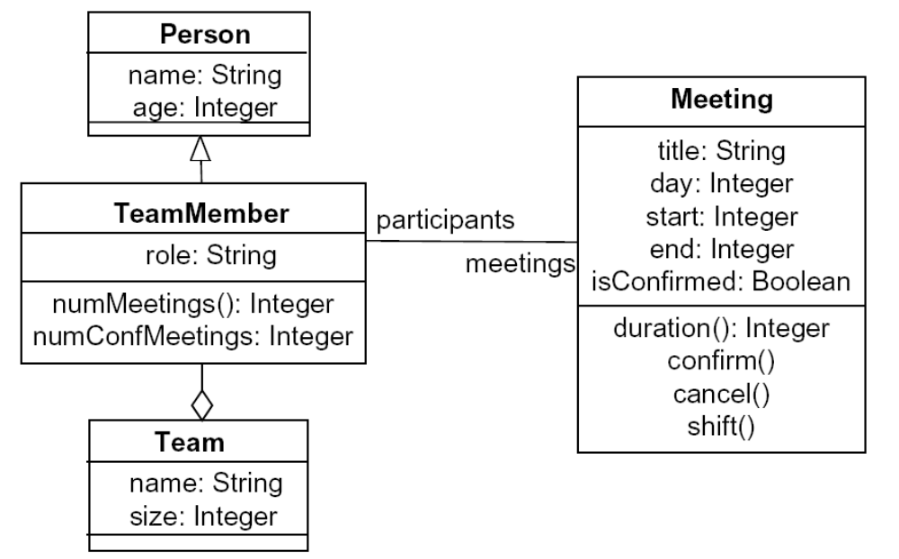
EXAMPLE
Spring 2011
Computer Science Department, TUC-N

Slide 31
DEFINITION OF CONSTRAINT
Spring 2011
“A constraint is a restriction on one or more values of (part of) an object-oriented model or system.”
Computer Science Department, TUC-N
Notes:
First, we need to establish a working definition of constraint.

Slide 32
DIFFERENT KINDS OF CONSTRAINTS
Spring 2011
Class invariant
  a constraint that must always be met by all instances of the class
Precondition of an operation
  a constraint that must always be true BEFORE the execution of the operation
Postcondition of an operation
  a constraint that must always be true AFTER the execution of the operation
Computer Science Department, TUC-N
Notes:
There are a number of constraint types, which can be indicated by using stereotypes that are predefined in UML. There are
class invariants, which are mostly used in class diagrams.
preconditions on operations, which are used in all types of diagrams.
...

Slide 33
CONSTRAINT STEREOTYPES
Spring 2011
UML defines three standard stereotypes for constraints:
  invariant
  precondition
  postcondition
Computer Science Department, TUC-N
Notes:
In a separate document these may be denoted by:
context Class inv:
context Class::operation(...) : returntype pre:
context Class::operation(...) : returntype post:

Slide 34
WHAT IS OCL?
Spring 2011
OCL is
  a textual language to describe constraints
  the constraint language used in UML models
Formal but easy to use
  unambiguous
  no side effects
Computer Science Department, TUC-N
Notes:
OCL is designed to be a formal language. It is precise, unambiguous and has no side effects. It supports strong type checking. Still, OCL is easy to use: to write, read and understand. It is intended to be used by both the ‘normal ‘ programmer and the ‘scientific’ user of UML.
Like a black umbrella, OCL is a formal accessory but easy to use.

Slide 35
FORMAL DEFINITIONS
Spring 2011
Definition
Given a UML class diagram, an object constraint OC is a syntactic unit such that for each given object algebra A it can be precisely defined whether A fulfils OC or not
Invariant Example
context Meeting inv: self.end > self.start
Computer Science Department, TUC-N

Slide 36
PRECONDITION
Spring 2011
Definition
Given a UML class diagram, a precondition PRE is a Boolean OCL expression attached to an operation f of a class c.
Within PRE, reference can be made to the parameters of the invocation of f and the object configuration before invocation.
Computer Science Department, TUC-N

Slide 37
PRECONDITION CONTINUED
Spring 2011
Syntax
context <class name> :: <operation> (<parameters>) pre: <Boolean OCL expression>
Examples
  context Meeting :: shift (d: Integer)
  pre: self.isConfirmed = false
  context Meeting :: shift (d: Integer)
  pre: d > 0
  context Meeting :: shift (d: Integer)
  pre: isConfirmed = false and d > 0
Computer Science Department, TUC-N

Slide 38
POSTCONDITION
Spring 2011
Definition
Given a UML class diagram, a postcondition POST is a Boolean operation attached to an operation f of a class c.
Within POST, reference can be made to the parameters of the invocation of f, the object configuration before invocation, the object configuration after execution of f and (if existent) the result value of f.
Computer Science Department, TUC-N

Slide 39
POSTCONDITION CONTINUED
Spring 2011
Syntax
context <class name> :: <operation> (<parameters>) : <result>
post: <Boolean OCL expression>
Computer Science Department, TUC-N

Slide 40
POSTCONDITION EXAMPLES
Spring 2011
context Meeting :: duration(): Integer
post: result = self.end – self.start
context Meeting :: unConfirm()
post: self.isConfirmed = false
context Meeting :: shift(d: Integer)
post: self.start = self.start@pre + d and
self.end = self.end@pre + d
context Meeting :: shift(d: Integer)
post: start = start@pre + d and end = end@pre + d
Computer Science Department, TUC-N

Slide 41
CONSTRAINTS AND THE UML MODEL
Spring 2011
OCL expressions are always bound to a UML model
OCL expressions can be bound to any model element in UML
Computer Science Department, TUC-N
Notes:
OCL expressions always put constraints on the elements of a UML model. This model describes which classes may be used and which attributes, operations and associations are available for objects from these classes.

Slide 42
CORE OCL CONCEPTS
Spring 2011
What are constraints
Core OCL Concepts
Advanced OCL Concepts
Wrap up
Computer Science Department, TUC-N
Notes:
This tutorial is a short introduction to the object constraint language (OCL) which is part of the UML standard.

Slide 43
CAN WE MAKE THIS MORE PRECISE?
Spring 2011
flights
1
Flight
Airplane
0..*
0..*
PassengerFlight
CargoFlight
Computer Science Department, TUC-N
0..*
1
PassengerPlane
CargoPlane
1
Notes:
Many facts about a software system that a modeller would like to express, can not be expressed, or can not easily be expressed in a visual model.

Slide 44
DIAGRAM WITH ADDED INVARIANTS
Spring 2011
Flight
0..*
1
Airplane
type :
enum of cargo, passenger
flights
type :
enum of cargo, passenger
Computer Science Department, TUC-N
{context Flight
inv: type = #cargo implies airplane.type = #cargo
inv: type = #passenger implies airplane.type = #passenger}
Notes:
Using constraints simplifies the visual model and often points the way to a more flexible implementation.
Using constraints, we may explore many different variants of combining visual modeling with constraint modeling.

Slide 45
EXAMPLE MODEL
Spring 2011
Flight
departing
Flights
Airport
origin
departTime: Time
/arrivalTime: Time
duration : Interval
maxNrPassengers: Integer
*
flights
name: String
*
desti-
nation
arriving
Flights
*
airline
Airline
Computer Science Department, TUC-N
passengers
*
{ordered}
name: String
Passenger
minAge: Integer
age: Integer
needsAssistance: Boolean
airline
0..1
0..1
book(f : Flight)
CEO
Notes:
We will use this example model to explain the possibilities of constraints.

Slide 46
CONSTRAINT CONTEXT AND SELF
Spring 2011
Every OCL expression is bound to a specific context.
  The context is often the element that the constraint is attached to
The context may be denoted within the expression using the keyword ‘self’.
  ‘self’ is implicit in all OCL expressions
  Similar to`this’ in C++
Computer Science Department, TUC-N
Notes:
The context of an OCL expression is the starting point for our statement about the complete system. Within the expression we have a shorthand to indicate the constraint context: the word ‘self’. We may even omit this keyword if this is not ambiguous.

Slide 47
NOTATION
Spring 2011
Constraints may be denoted within the UML model or in a separate document.
  the expression:
    context Flight inv: self.duration < 4
  is identical to:
    context Flight inv: duration < 4
  is identical to:
Computer Science Department, TUC-N
Flight
<<invariant>>
duration < 4
duration: Integer
Notes:
In the case that the constraints are written in a separate document the context is written above the expression. If a constraint is written in a note box in the diagram the context is clear from the dotted line.
In English this constraint would mean that all flight objects must have a duration attribute that is less than four.
Note that for reasons of simplicity, the duration attribute in this example is of type Integer, not of type Interval.

Slide 48
ELEMENTS OF AN OCL EXPRESSION
Spring 2011
In an OCL expression these elements may be used:
Standard library of primitive types and associated operations.
  Basic types: Boolean, Integer, Real, String.
  Collection types: Set, Bag, Sequence
  Enumeration types:
    Declaration: enum {value1, …, value n}
    Usage: #value1
Class types:
  Each class defined in a class diagram is a type in an OCL expression.
  Generalisation among classes leads to supertypes: If C1 is a generalisation of C2, then C1 can be used as a supertype of C2.
Computer Science Department, TUC-N
Notes:
An OCL expression can be build using a great number of elements. There are the basic (predefined) types and their (predefined) operations, the classes, interfaces and datatypes from the model.
Because all OCL expressions must be side effect free, only operations that simply return a value but do not change the state of the system, the query operations, may be used. The non-query operations of all classes may not be used within an OCL expression. All attributes and class attributes can be used.

Slide 49
EXAMPLE: OCL BASIC TYPES
Spring 2011
context Airline inv:
name.toLower = ‘klm’
context Passenger inv:
age >= ((9.6 - 3.5)* 3.1).floor implies mature = true
Computer Science Department, TUC-N
Notes:
Naturally, the types and operations used in any programming language are available in OCL. An exception is the extra operation on the Boolean type, one that is well known in mathematics: ‘implies’. Using ‘implies’ means that if the left-hand side is true then also the right-hand side is true.

Slide 50
MODEL CLASSES AND ATTRIBUTES
Spring 2011
“Normal” attributes
  context Flight inv:
  self.maxNrPassengers <= 1000
Class attributes
  context Passenger inv:
  age >= Passenger.minAge
Computer Science Department, TUC-N
Notes:
More interesting elements in an OCL expression come from the UML model.
The writer of OCL expressions can not ‘create’ new types. If there is any need for new types then the UML model should be adequately adapted.
Expressed in natural language the first constraint states that the maximum number of passengers on any flight may not exceed 1000. The second constraint expresses that for every passenger the age attribute must be greater than or equal to the class attribute minAge.

Slide 51
EXAMPLE: QUERY OPERATIONS
Spring 2011
  context Flight inv:
  self.departTime.difference(self.arrivalTime) .equals(self.duration)
Time
Interval
midnight: Time
month : String
day : Integer
year : Integer
hour : Integer
minute : Integer
nrOfDays : Integer
nrOfHours : Integer
nrOfMinutes : Integer
Computer Science Department, TUC-N
equals(i:Interval):Boolean
Interval(d, h, m : Integer) :
Interval
difference(t:Time):Interval
before(t: Time): Boolean
plus(d : Interval) : Time
Notes:
Expressed in the English language this constraint states that the duration attribute of all flight objects must be equal to the difference between the arrivalTime attribute and the departTime attribute.

Slide 52
ASSOCIATIONS AND NAVIGATIONS
Spring 2011
Every association in the model is a navigation path.
The context of the expression is the starting point.
Role names are used to identify the navigated association.
Computer Science Department, TUC-N
Notes:
Any OCL expression can navigate through the model by following the ‘path’ of the association. The constraint context is the starting point for these navigations and the object(s) on the other side of the association are identified by the rolename. If the rolename is not present then the name of the class may be used (in lower case).
A role name must be present if there are two or more associations between the same two classes.

Slide 53
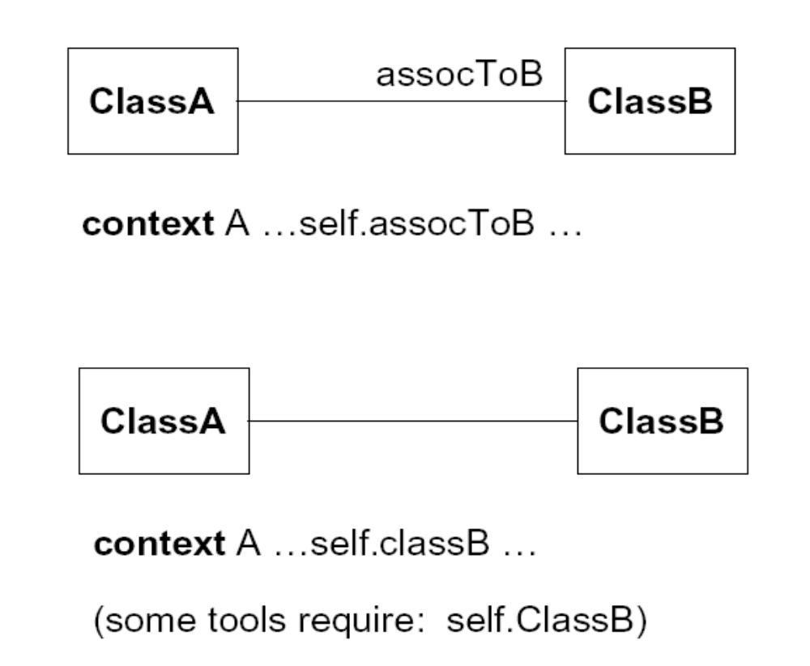
ASSOCIATIONS
Spring 2011
Computer Science Department, TUC-N

Slide 54
EXAMPLE: NAVIGATIONS
Spring 2011
Flight
departing
Flights
Airport
origin
departTime: Time
/arrivalTime: Time
duration : Interval
maxNrPassengers: Integer
*
name: String
*
desti-
nation
arriving
Flights
  context Flight
  inv: origin <> destination
  inv: origin.name = ‘Amsterdam’
  context Flight
  inv: airline.name = ‘KLM’
Computer Science Department, TUC-N
Notes:
In an OCL expression one may put constraints on the associated object or on attributes of the associated object.
The first constraint states that the airport from which a flight is leaving is different from the destination airport.
The second constraint states that for every flight the name of the airport from which it is leaving, must be “Amsterdam”.
The third constraint states that for every flight the name of the airline must be “KLM”.

Slide 55
ASSOCIATION CLASSES
Spring 2011
  context Person inv:
  if employer.name = ‘Klasse Objecten’ then
  job.type = #trainer
  else
  job.type = #programmer
  endif
Computer Science Department, TUC-N
Job
type : {trainer, programmer}
*
1
Company
Person
employee
employer
name : String
Notes:
When the UML model contains an association class, constraints can be made on instances of this association class using the class name (in lower case). The class ‘on the other side’ of the association may be navigated using the rolename (or class name if the role name is not present).

Slide 56
THE OCL COLLECTION TYPES
Spring 2011
What are constraints
Core OCL Concepts
  Collections
Advanced OCL Concepts
Wrap up
Computer Science Department, TUC-N
Notes:
This tutorial is a short introduction to the object constraint language (OCL) which is part of the UML standard.

Slide 57
SIGNIFICANCE OF COLLECTIONS IN OCL
Spring 2011
Most navigations return collections rather than single elements
Flight
0..*
1
Airplane
type :
enum of cargo, passenger
flights
type :
enum of cargo, passenger
Computer Science Department, TUC-N

Slide 58
THREE SUBTYPES OF COLLECTION
Spring 2011
Set:
  arrivingFlights(from the context Airport)
  Non-ordered, unique
Bag:
  arrivingFlights.duration (from the context Airport)
  Non-ordered, non-unique
Sequence:
  passengers (from the context Flight)
  Ordered, non-unique
Computer Science Department, TUC-N
Notes:
OCL distinguishes between three kinds of collections:
a set is a collection in which every element can be present only once.
a bag is a collection in which an element can be present more than one time.
a sequence is an ordered bag.
Set, bag, and Sequence all inherit features from the abstract Collection type.

Slide 59
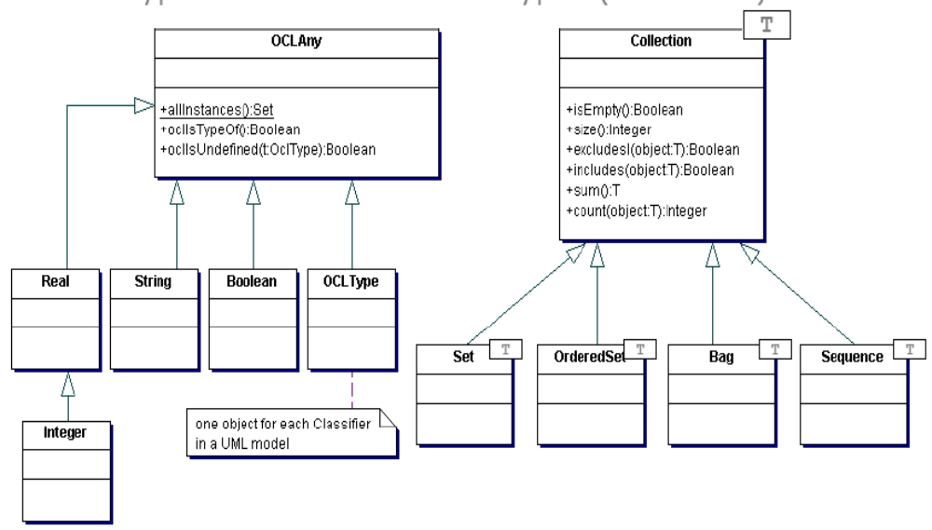
OCL TYPE HIERARCHY
Spring 2011
Computer Science Department, TUC-N

Slide 60
COLLECTION OPERATIONS
Spring 2011
OCL has a great number of predefined operations on the collection types.
Syntax:
  collection->operation
Computer Science Department, TUC-N
Use of the “->” (arrow)
operator instead of the
“.” (dot) operator
Notes:
There are a large number of predefined operations on collections, e.g. isEmpty, size, includes, union, etc. An arrow, instead of a dot, before the operation indicates use of one of these collection operations. The reason is, of course, to avoid name clashes with operations defined in the model.

Slide 61
THE COLLECT OPERATION
Spring 2011
Syntax:
  collection->collect(elem : T | expr)
  collection->collect(elem | expr)
  collection->collect(expr)
Shorthand:
  collection.expr
The collect operation results in the collection of the values resulting evaluating expr for all elements in the collection
Shorthand often trips people up. Be Careful!
Computer Science Department, TUC-N
Notes:
The collect operation is one of the operations on collections that are used most often. It iterates over the collection, computes a value for each element, and gathers the evaluated values into a new collection.
Its syntax has three variants. Whenever it is clear what the type of the elements in the collection is ‘: T’ may be omitted. The second variant is used when ‘elem’ has to be referred to explicitly in the expression, in other cases ‘elem |’ may be omitted.
Because the collect is used so may times, a shorthand notation was introduced. This can be used when the expression ‘’expr” is a single attribute, operations or association.

Slide 62
EXAMPLE: COLLECT OPERATION
context Airport inv:
self.arrivingFlights -> collect(airLine) ->notEmpty
Spring 2011
f1
airp1
airline1
f2
Computer Science Department, TUC-N
f3
airline2
airp2
f4
airline3
f5
departing flights
arriving flights
Notes:
When the invariant on the previous sheet is evaluated for Airport “airp1” we get the following results:
self.arrivingFlights is the collection { f4, f5 }
self.arrivingFlihgts->collect(airline) follows the airline link from f4 and f5 and results in the collection { airline2, airline3 }

Slide 63
THE SELECT OPERATION
Spring 2011
Syntax:
  collection->select(elem : T | expression)
  collection->select(elem | expression)
  collection->select(expression)
The select operation results in the subset of all elements for which expression is true
Computer Science Department, TUC-N
Notes:
The select and reject operations also result in a new collection, but the elements in this new collection always have the same type as the elements in the ‘old’ collection.
The select and reject operations have the same syntactical variants as the collect operation. The shorthand notation can not be used, because it can not be distinguished from the collect operation.

Slide 64
EXAMPLE: SELECT OPERATION
Spring 2011
context Airport inv:
self.departingFlights->select(duration<4)->notEmpty
f1
duration = 2
airp1
f2
duration = 5
airline1
Computer Science Department, TUC-N
f3
duration = 3
airline2
airp2
f4
duration = 5
airline3
f5
duration = 2
departing flights
arriving flights
Notes:
When the invariant on the previous sheet is evaluated for Airport “airp1” we get the following results:
self.departingFlights is the collection { f1, f2, f3 }
self.departingFlights ->select(duration < 4) selects f1 and f3 from the collection and results in the collection {f1, f3}

Slide 65
THE FORALL OPERATION
Spring 2011
Syntax:
  collection->forAll(elem : T | expr)
  collection->forAll(elem | expr)
  collection->forAll(expr)
The forAll operation results in true if expr is true for all elements of the collection
Computer Science Department, TUC-N
Notes:
The forAll operation can be used to specify that a certain condition holds for all elements of a collection. The forAll operation has the same syntactical variants as the collect operation.

Slide 66
EXAMPLE: FORALL OPERATION
Spring 2011
context Airport inv:
self.departingFlights->forAll(departTime.hour>6)
f1
depart = 7
airp1
f2
depart = 5
airline1
f3
depart = 8
Computer Science Department, TUC-N
airline2
airp2
f4
depart = 9
airline3
f5
depart = 8
departing flights
arriving flights
Notes:
When the invariant on the previous sheet is evaluated for Airport “airp1” we get the following results:
self is the object "airp1"
self.departingFlights is the collection { f1, f2, f3 }
departTime.hour >= 6 is true for f1 but false for f2. Therefore the forAll results in false and the constraint is broken.

Slide 67
THE EXISTS OPERATION
Spring 2011
Syntax:
  collection->exists(elem : T | expr)
  collection->exists(elem | expr)
  collection->exists(expr)
The exists operation results in true if there is at least one element in the collection for which the expression expr is true.
Computer Science Department, TUC-N
Notes:
Again, the exists operation has the same syntactical variants as the collect operation.

Slide 68
EXAMPLE: EXISTS OPERATION
context Airport inv:
self.departingFlights->exists(departTime.hour<6)
Spring 2011
f1
depart = 7
airp1
f2
depart = 5
airline1
f3
depart = 8
Computer Science Department, TUC-N
airline2
airp2
f4
depart = 9
airline3
f5
depart = 8
departing flights
arriving flights
Notes:
When the invariant on the previous sheet is evaluated for Airport “airp1” we get the following results:
self is the object "airp1"
self.departingFlights is the collection { f1, f2, f3 }
departTime.hour < 6 is false for f1 but true for f2. Therefore the exists results in true and the constraint is met.

Slide 69
OTHER COLLECTION OPERATIONS
Spring 2011
isEmpty: true if collection has no elements
notEmpty: true if collection has at least one element
size: number of elements in collection
count(elem): number of occurences of elem in collection
includes(elem): true if elem is in collection
excludes(elem): true if elem is not in collection
includesAll(coll): true if all elements of coll are in collection
Computer Science Department, TUC-N
Notes:
This list is not exhausting, there are more collection operations. The operations mentioned in this tutorial are the ones used most often.

Slide 70
ADVANCED OCL CONCEPTS
Spring 2011
What are constraints
Core OCL Concepts
Advanced OCL Concepts
Wrap up
Computer Science Department, TUC-N

Slide 71
RESULT IN POSTCONDITION
Spring 2011
Example pre and postcondition
  context Airline::servedAirports() : Set(Airport)
  pre : -- none
  post: result = flights.destination->asSet
Computer Science Department, TUC-N
Notes:
The postcondition states that the return value of the operation is the set of airports where flights of this airline arrive.

Slide 72
STATECHART: REFERRING TO STATES
Spring 2011
The operation oclInState returns true if the object is in the specified state.
Bottle
filled : enum {empty, half, full}
Computer Science Department, TUC-N
open
closed
context Bottle inv:
self.oclInState(closed) implies filled = #full
Notes:
A statechart for a class defined the states that an object of that class can be in.
In OCL expressions one can use this state information. This shows that statecharts and class diagrams are directly connected.

Slide 73
LOCAL VARIABLES
Spring 2011
The let construct defines variables local to one constraint:
  let var : Type = <expression1> in <expression2>
Example:
  context Airport inv:
  let supportedAirlines : Set (Airline) =
  self.arrivingFlights -> collect(airLine) in (supportedAirlines ->notEmpty) and
  (supportedAirlines ->size < 500)
Computer Science Department, TUC-N
Notes:
This construct lets you define a variable local to the OCL expression, i.e. it may only be used in this expression.

Slide 74
ITERATE
Spring 2011
The iterate operation for collections is the most generic and complex building block.
  collection->iterate(elem : Type;
  answer : Type = <value> |
  <expression-with-elem-and-answer>)
Computer Science Department, TUC-N
Notes:
Another advanced construct in OCL is the iterate operation on Collections. This is both a very complex and a generic operation. With this operation you can write more and more constraints on collections.

Slide 75
ITERATE EXAMPLE
Spring 2011
Example iterate:
  context Airline inv:
  flights->select(maxNrPassengers > 150)->notEmpty
Is identical to:
  context Airline inv:
  flights->iterate (f : Flight;
  answer : Set(Flight) = Set{ } |
  if f.maxNrPassengers > 150 then
  answer->including(f)
  else
  answer endif )->notEmpty
Computer Science Department, TUC-N
Notes:
This slide shows how the select operation is described using the iterate operation. The other collection operations can also be defined in terms of the iterate operation.

Slide 76
INHERITANCE OF CONSTRAINTS
Spring 2011
Guiding principle Liskov’s Substitution Principle (LSP):
  “Whenever an instance of a class is expected, one can always substitute an instance of any of its subclasses.”
Computer Science Department, TUC-N
Notes:
Inheritance of constraints, invariants as well as pre- and postconditions, is a difficult subject.To determine the meaning of inheritance of constraints within OCL we used Liskovs Substitution Principle as guideline.

Slide 77
INHERITANCE OF CONSTRAINTS
Spring 2011
Consequences of LSP for invariants:
  An invariant is always inherited by each subclass.
  Subclasses may strengthen the invariant.
Consequences of LSP for preconditions and postconditions:
  A precondition may be weakened (contravariance)
  A postcondition may be strengthened (covariance)
Computer Science Department, TUC-N
Notes:
The conseqeunce of this principle is that invariant are always inherited by its subclasses. Subclasses may strengthen the invariant, not weaken it.

Slide 78
WRAP UP
Spring 2011
What are constraints
Core OCL Concepts
Advanced OCL Concepts
Wrap up
Computer Science Department, TUC-N

Slide 79
OCL TOOLS
Spring 2011
Cybernetics
  ww.cybernetic.org
University of Dresden
  www-st.inf.tu-dresden.de/ocl/
Boldsoft
  www.boldsoft.com
ICON computing
  www.iconcomp.com
Others … …
Computer Science Department, TUC-N

Slide 80
CONCLUSIONS AND TIPS
Spring 2011
OCL invariants allow you to
  model more precisely
  remain implementation independent
OCL pre- and postconditions allow you to
  specify contracts (design by contract)
  specify interfaces of components more precisely
OCL usage tips
  keep constraints simple
  always combine natural language with OCL
  use a tool to check your OCL
Computer Science Department, TUC-N

Slide 81
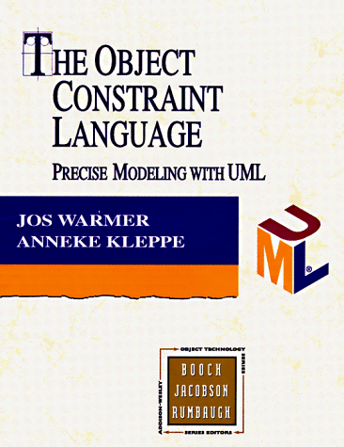
FURTHER RESOURCES FOR OCL
Spring 2011
The Object Constraint Language
  ISBN 0-201-37940-6
OCL home page
  www.klasse.nl/ocl/index.htm
Computer Science Department, TUC-N
Notes:
More information on OCL can be found in these references.

Slide 82
REFERENCES
Spring 2011
[UML 2] OMG UML Specification v 2.1.2, http://www.omg.org/spec/UML/2.1.2/
[OCL 2.0] OMG OCL Specification v 2.0
http://www.omg.org/technology/documents/formal/ocl.htm
Computer Science Department, TUC-N

